Slide 1
Modular Intrusion Prevention System
Rajendra Kumar Nitish Garg
Harsha Vardhan
Ravi Chandra Anshul

Slide 2



Objective

Slide 3

How did we do it ...
Monitored Logs

Slide 4

How did we do it ...
Monitored Logs
identify failed attempts

Slide 5

How did we do it ...
Monitored Logs
identify failed attempts
Block Identified Ip Temporarily

Slide 6
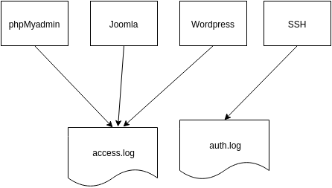
Monitoring logs..

Slide 7
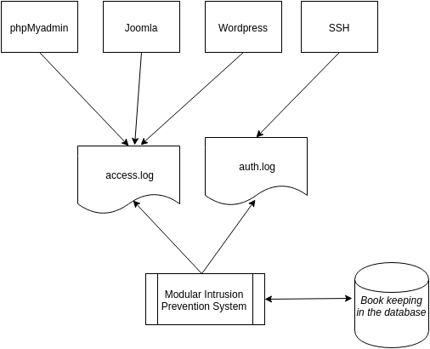
Monitoring logs..

Slide 8

Database Information ..
Max Attempts | Time to consider | Time to Block
Client Ip | Block Start | Force Remove
Ip | Hit time | Application

Slide 9
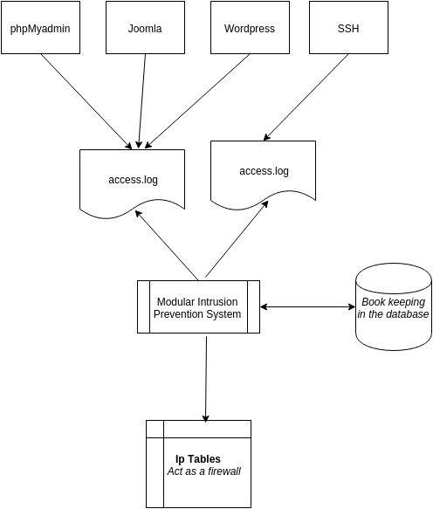
Blocking Suspicious Ip ..

Slide 10

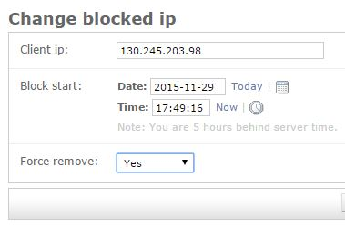
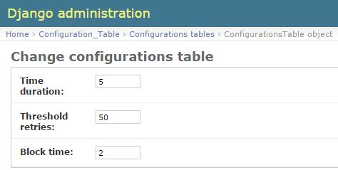


Admin Interface..
Admin Interface
Max Attempts | Time to consider | Time to Block
Client Ip | Block Start | Force Remove

Slide 11

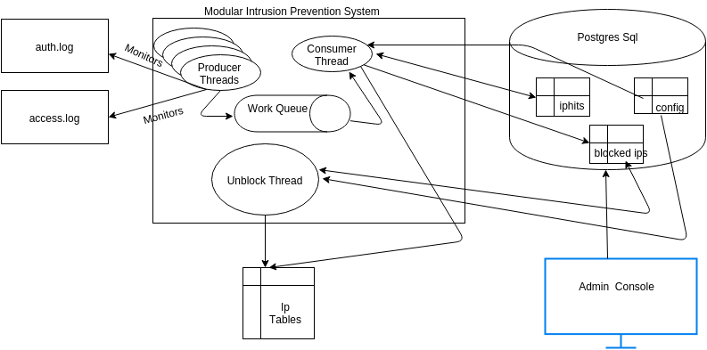
Technical Overview ….

Slide 12
Modules and Contributions
RajendraKumar : Designed and Deployed Intrusion Prevention System
Harsha : Design and Develop Admin Interface
Anshul : Wrote Log parser and deployed phpmyadmin
Nitish Garg : Designed Db tables and Deployed PLSQL and MYSQL
Ravi Chandra : Developed ORM for threads and Admin interface to the DB

